Slide 1
Saliency Selector
Quality conscious efficiency saliency selector
By-
Ramyanee Kashyap MT21139
Sayan Mitra MT21142
Shoumik Bhattacharya MT21144

Slide 2
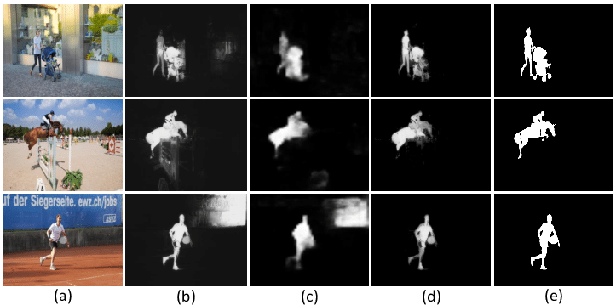
Problem Statement
Input: A small randomly sampled subset of an image dataset.
Output: The best saliency extraction method for the input set of images.
Pre-processing: Resize each input set image so that all images are of the same shape.
Output Evaluation: The output can be evaluated based on the quality of saliency map obtained.

Slide 3
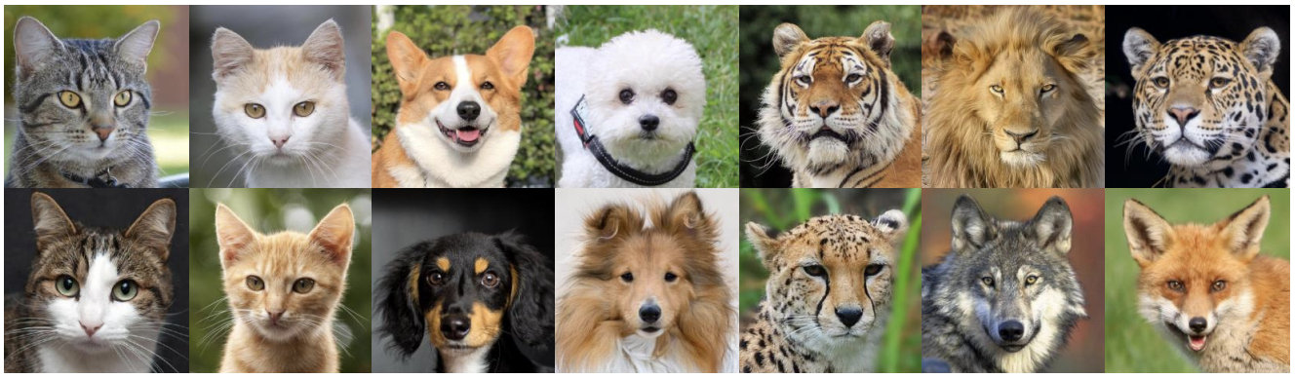
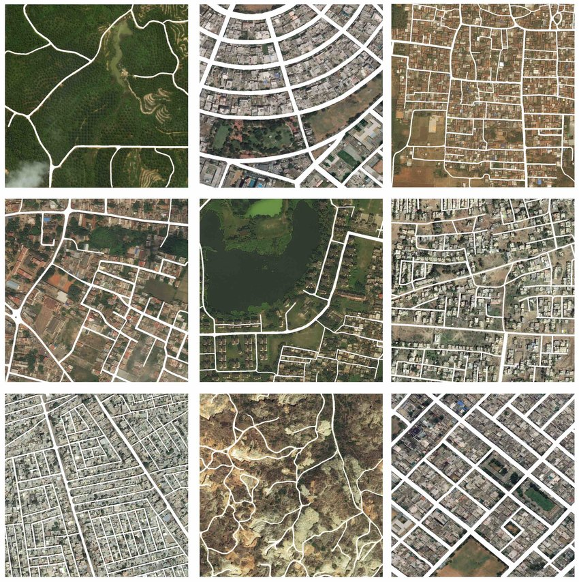
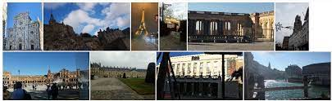
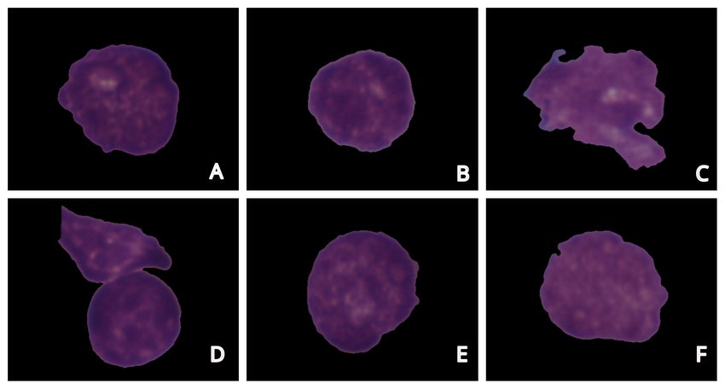
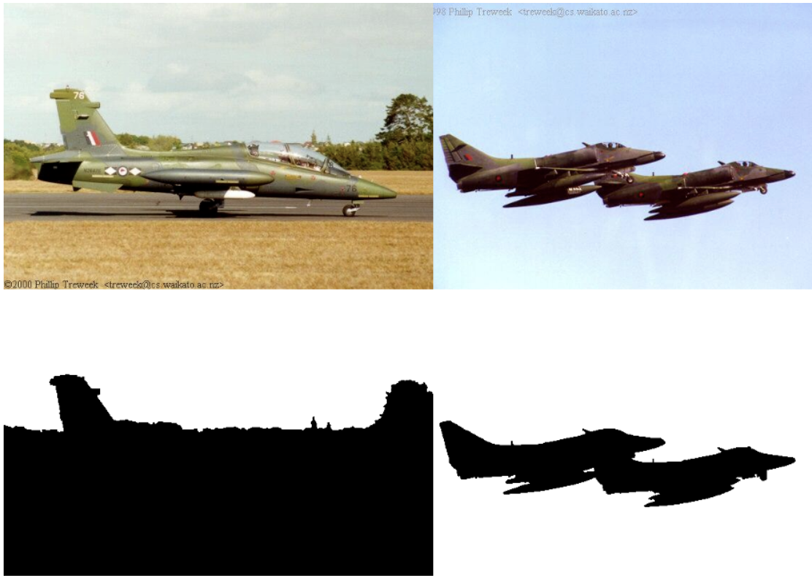
Different Saliency detection techniques may be optimal depending on the type of dataset
What is the most optimal way of saliency detection for the dataset at hand?

Slide 4
Methodology
The objective of this project is:
To automate the process of selecting a suitable saliency detection method for a set of similar images.
To find the best saliency method in an efficient manner.
To get the best saliency map for the input image set.
To take into consideration both computational efficiency and quality measure while selecting a saliency method.

Slide 5
Novelty and Contribution
Current literature in saliency involves quality assessment of saliency methods based on their ability to find the region of the image which is most likely to grab the attention of the viewer. However little attention has been given to the need to select an efficient saliency model for a specific task at hand.
In this project we aim to find a robust method to select the optimal saliency detection technique given an image dataset while taking into consideration both quality measure and computational time. The goal is to arrive at a suitable tradeoff between saliency detection quality and the time required in the process to finally suggest the suitable method of saliency detection given an image dataset.

Slide 6
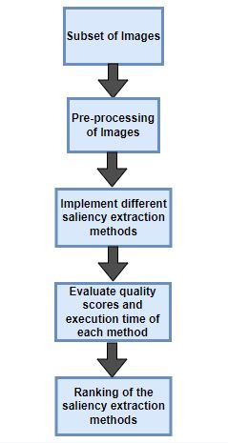
Methodology
Take a randomly sampled subset as representative of the given dataset.
Extract for each of these images using various saliency extraction methods.
Assess each of these saliency maps using saliency quality score.
Use time taken by each method to reward/penalise the quality score.
Sort the methods in preference order by the final score.

Slide 7
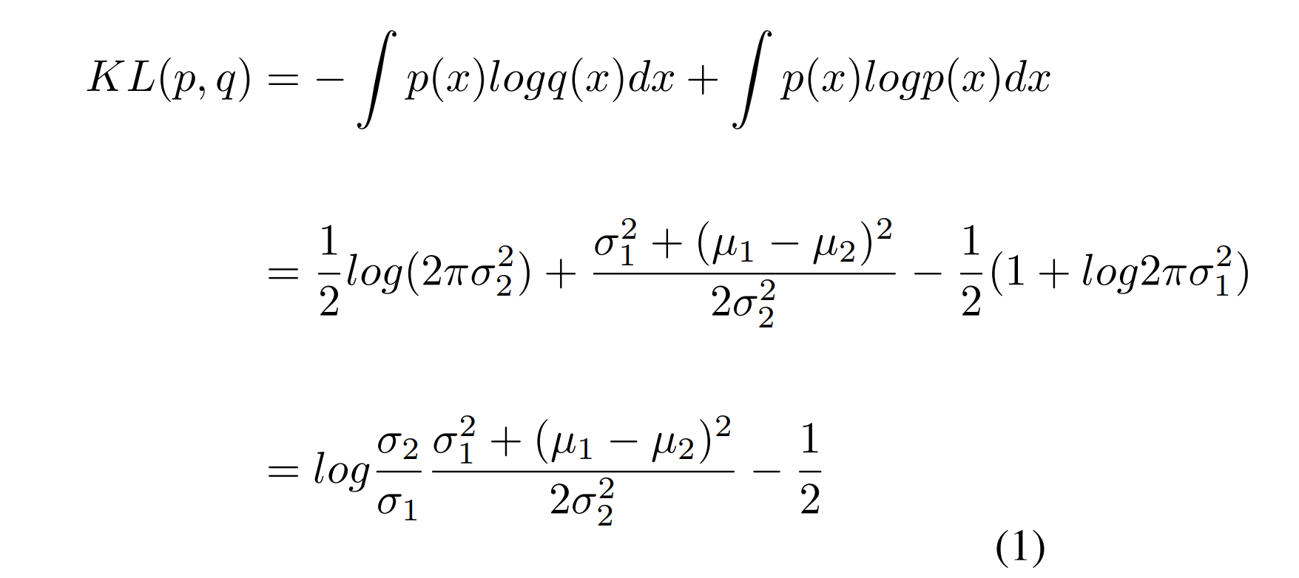
Quality Measure - Separation between BG and FG
Separation between background and foreground distribution using Kullback–Leibler divergence between representative normal distributions.

Slide 8
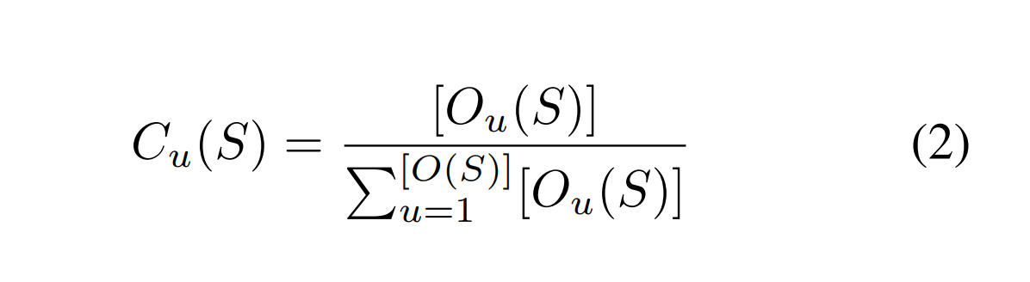
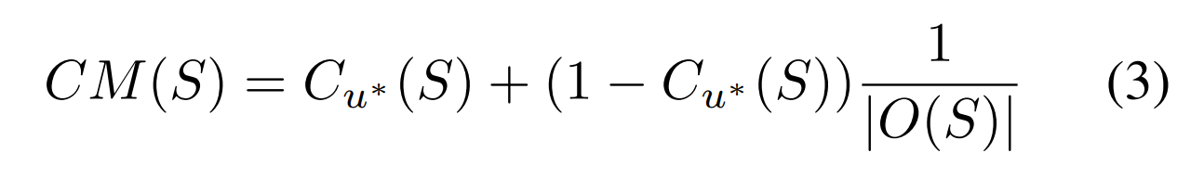
Quality Measure - Concentration
Concentration measure is taken as given in [7].
﻿C_{u}(S) is the fraction of the total foreground area covered by the object component O_{u}(S)
Concentration measure can then be calculated as:

Slide 9
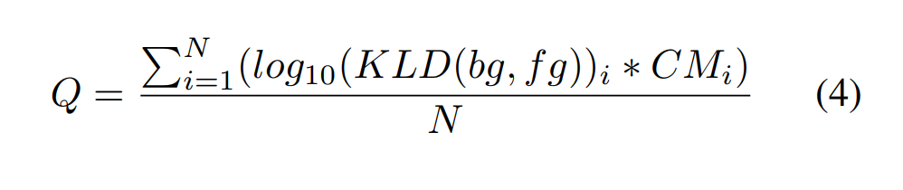
Quality Score
Quality score can then be computed as:

Slide 10
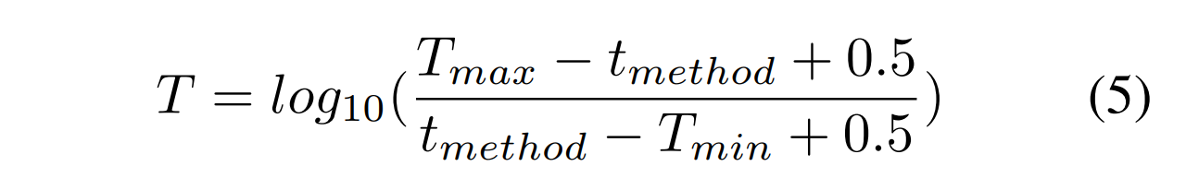
Time Measure
T_{max}: Time taken by the slowest method.
T_{min}: Time taken by the fastest method.

Slide 11
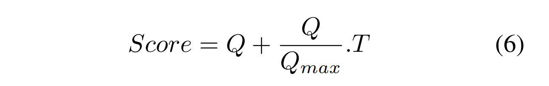
Final Score
Final score is a combination of time and quality

Slide 12
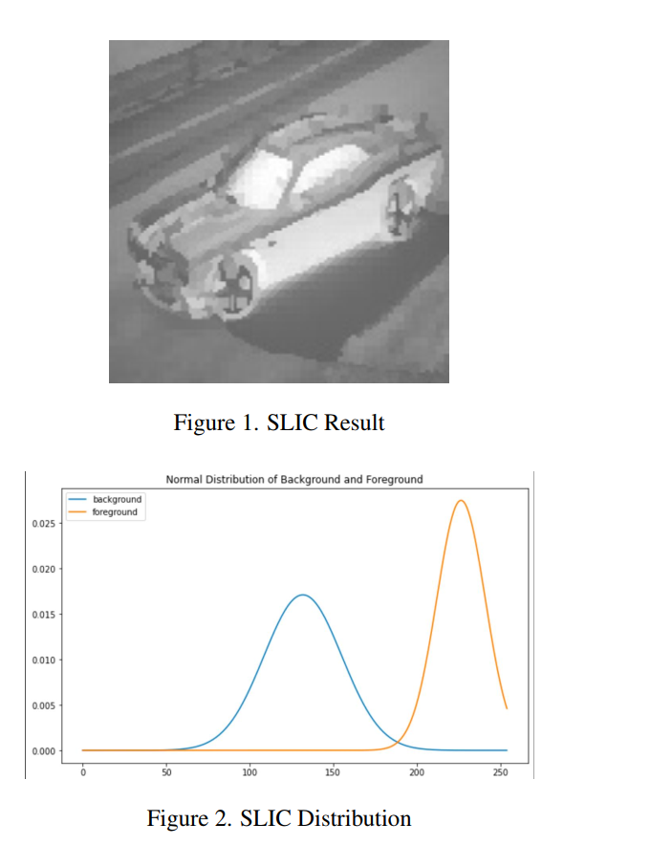
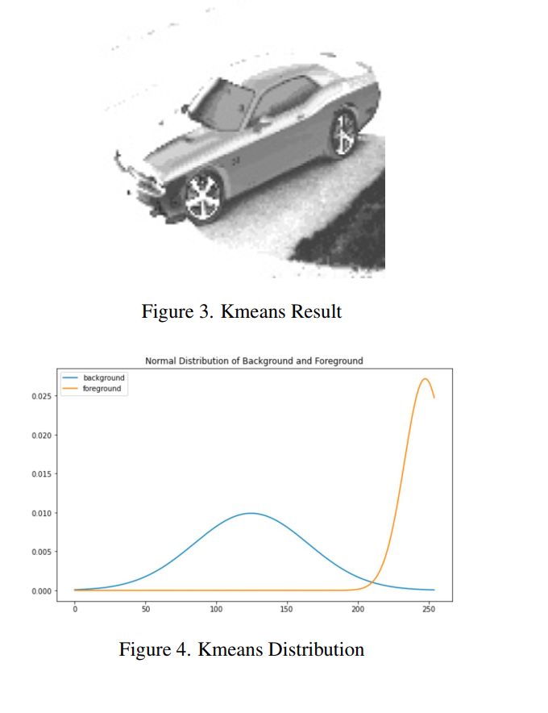
Experimental Results
Visualization of Separation between background and foreground distribution.

Slide 13
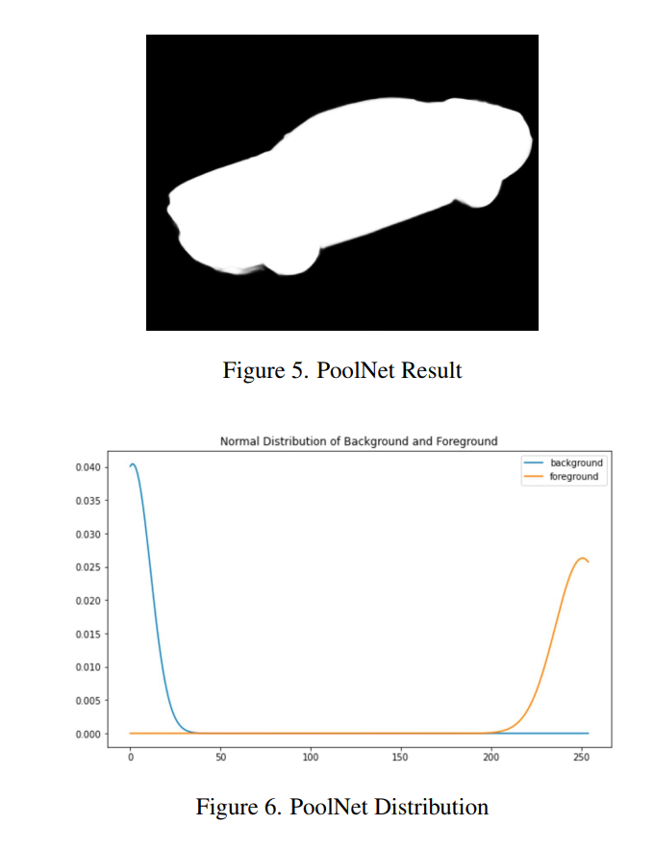
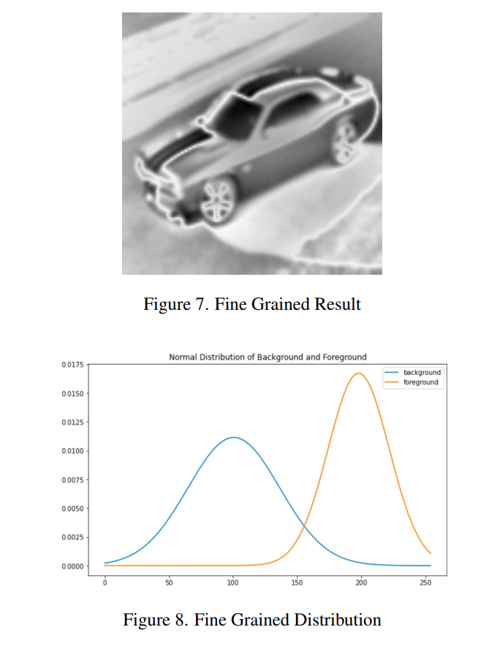
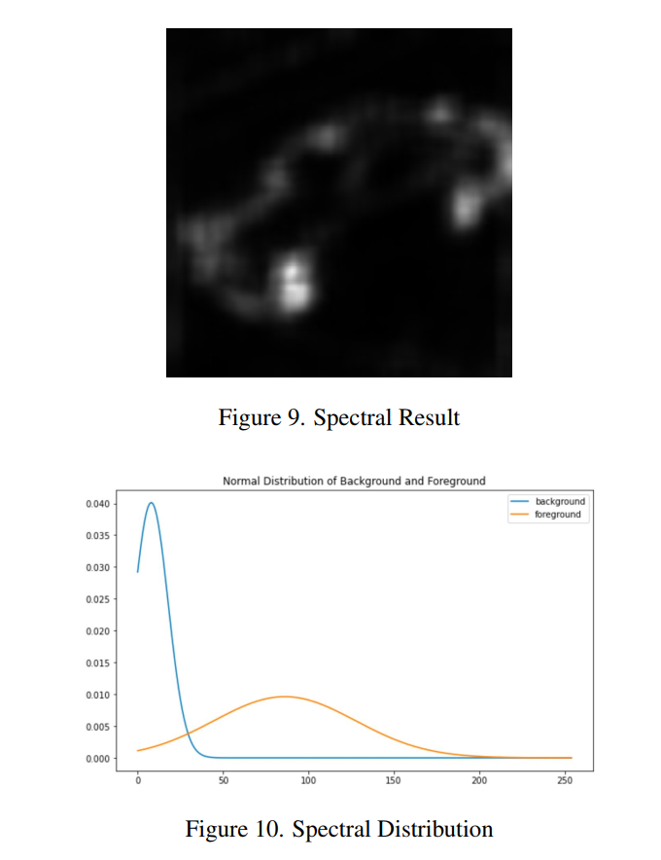
Experimental Results

Slide 14
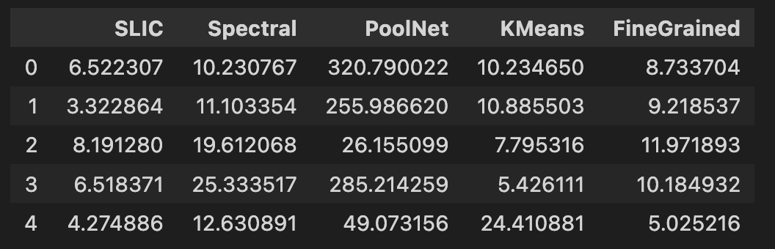
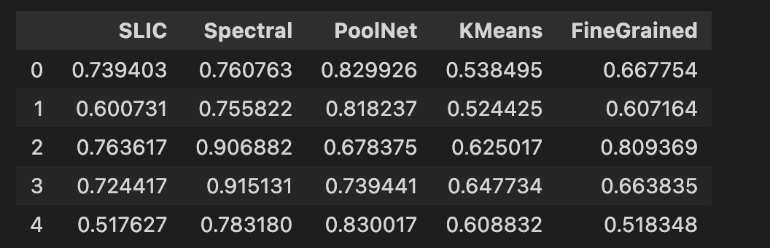
Experimental Results
KLD values: Concentration Measure values:

Slide 15
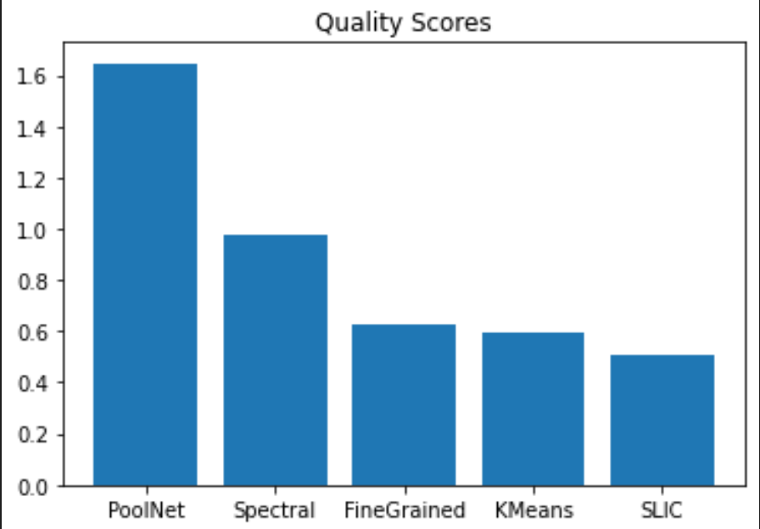
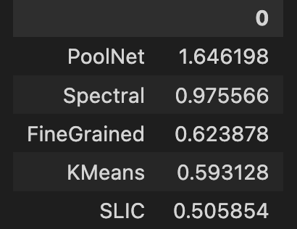
Experimental Results
Quality Measures

Slide 16
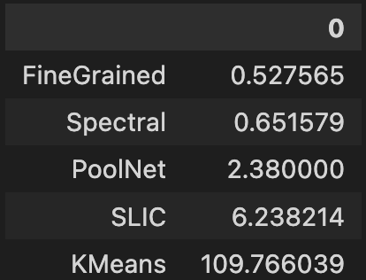
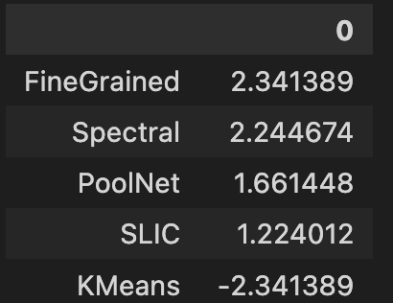
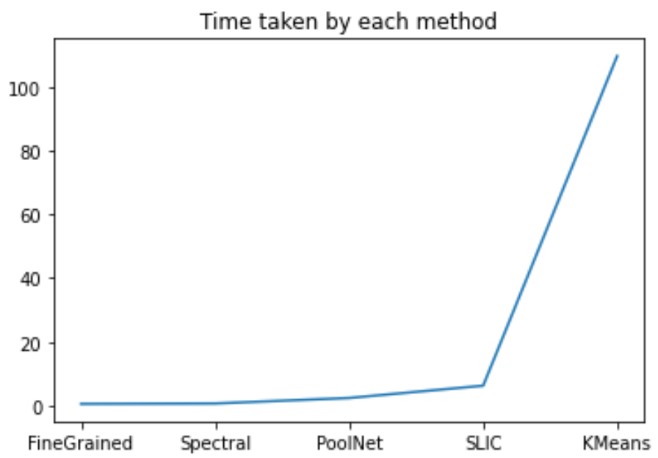
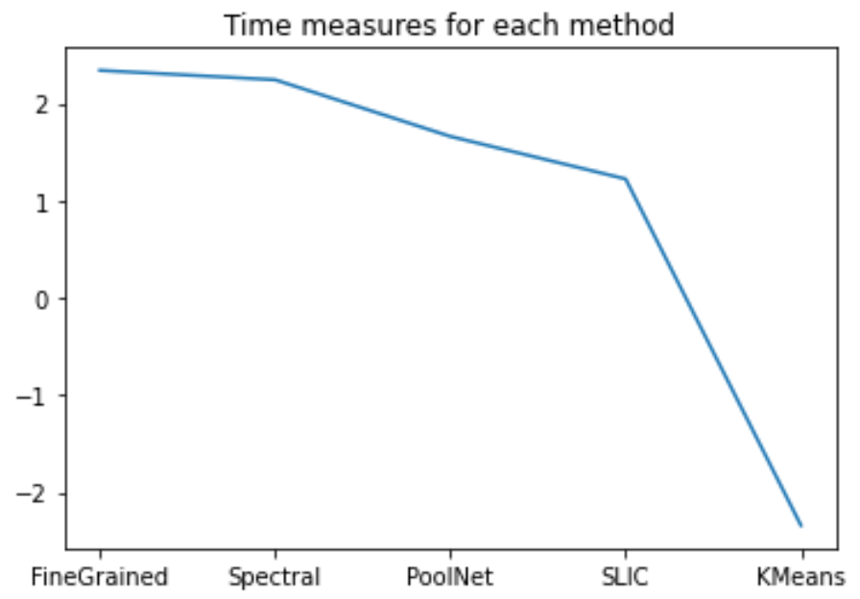
Experimental Results
Time taken by each method Time measure for each method

Slide 17
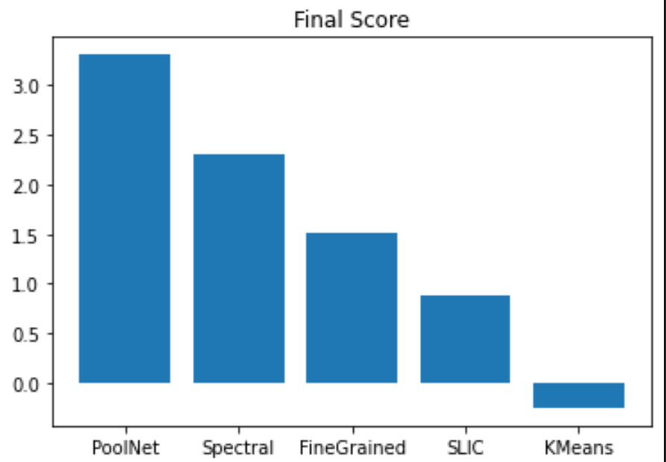
Experimental results

Slide 18
Conclusion
Assuming distribution of foreground and background pixels follow normal distribution, KL Divergence between the two distributions can be computed using a closed form solution which makes the process very fast. KL Divergence gives us an idea about how well separated foreground and background pixels are in the saliency map. Concentration measure gives an idea about how well connected the foreground blobs are in the saliency maps. These two measures combined gives us the overall idea about the quality of the saliency map. This quality score has been rewarded or penalized on the basis of how fast the saliency extraction method has been.
The method proposed in this paper gives us the time sensitive ranking of various saliency extraction methods for a input dataset. The final rankings of various saliency extraction methods in the tables shown above highlight that Deep Learning based PoolNet gives the best quality saliency map with reasonably lesser time consumption.

Slide 19
References
[1] A. Borji, H. R. Tavakoli, D. N. Sihite, and L. Itti, “Analysis of Scores, Datasets, and Models in Visual Saliency Prediction,” in 2013 IEEE International Conference on Computer Vision, Dec. 2013, pp. 921–928. doi: 10.1109/ICCV.2013.118.
[2] Z. Bylinskii, T. Judd, A. Oliva, A. Torralba, and F. Durand, “What do different evaluation metrics tell us about saliency models?,” arXiv:1604.03605 [cs], Apr. 2017, Accessed: Mar. 20, 2022. [Online]. Available: http://arxiv.org/abs/1604.03605
[3] T. Judd, F. Durand, and A. Torralba, “A Benchmark of Computational Models of Saliency to Predict Human Fixations,” Jan. 2012, Accessed: Mar. 20, 2022. [Online]. Available: https://dspace.mit.edu/handle/1721.1/68590
[4] A. Borji, D. N. Sihite, and L. Itti, “Quantitative Analysis of Human-Model Agreement in Visual Saliency Modeling: A Comparative Study,” IEEE Transactions on Image Processing, vol. 22, no. 1, pp. 55–69, Jan. 2013, doi: 10.1109/TIP.2012.2210727.
[5] L. Mai and F. Liu, “Comparing Salient Object Detection Results without Ground Truth,” in Computer Vision – ECCV 2014, Cham, 2014, pp. 76–91. doi: 10.1007/978-3-319-10578-9_6.
[6] Y. K. Kim and and K. M. Lee, “Saliency Score-Based Visualization for Data Quality Evaluation,” International Journal of Fuzzy Logic and Intelligent Systems, vol. 15, no. 4, pp. 289–294, Dec. 2015, doi: 10.5391/IJFIS.2015.15.4.289.
[7] K. R. Jerripothula, J. Cai, and J. Yuan, “Quality-Guided Fusion-Based Co-Saliency Estimation for Image Co-Segmentation and Colocalization,” IEEE TRANSACTIONS ON MULTIMEDIA, vol. 20, no. 9, p. 12, 2018.

